Slide 1


FACIAL EMOTION DETECTION USING NEURAL NETWORK
Under the guidance of
PROF. CHHAYA S DULE
Special topics II

Slide 2

Team members (#40)
Lakshman Parihar m(ENG19CS0152)
Kaushal Yadav (ENG19CS0139)
Krishna Kant Bishnoi (ENG19CS0147)
Abhishek Singh (ENG19CS0311)

Slide 3
Overview
Introduction
Problem definition
Objectives
Requirements
Proposed methodology
Solution proposed
Diagrams
Implementation
Testing
Conclusion

Slide 4
Introduction
The human face is the most intricate and versatile of all animals. Using our face alone, we can communicate a wealth of information to others.
A smile to show happiness or agreement.
A frown to let someone know you are unhappy.
A lowering of your brows to show someone you are angry or frustrated.
A raise of the eyebrows to ask a question or emphasize a word.
These are all ways that we purposely manipulate the muscles in our faces to show another person a particular message, thought or feeling. With 43 muscles in the face, sitting just under the skin’s surface, they can produce 1000’s of different facial expressions when moved and manipulated.

Slide 5
While many of these expressions will not carry any significant meaning or value to others, there are seven particular facial expressions we should all know about and know how to spot them the 7 universal facial expression of emotion
Specifically – Happy, Sad, Anger, Fear, Surprise, Neutral and Disgust.

Slide 6
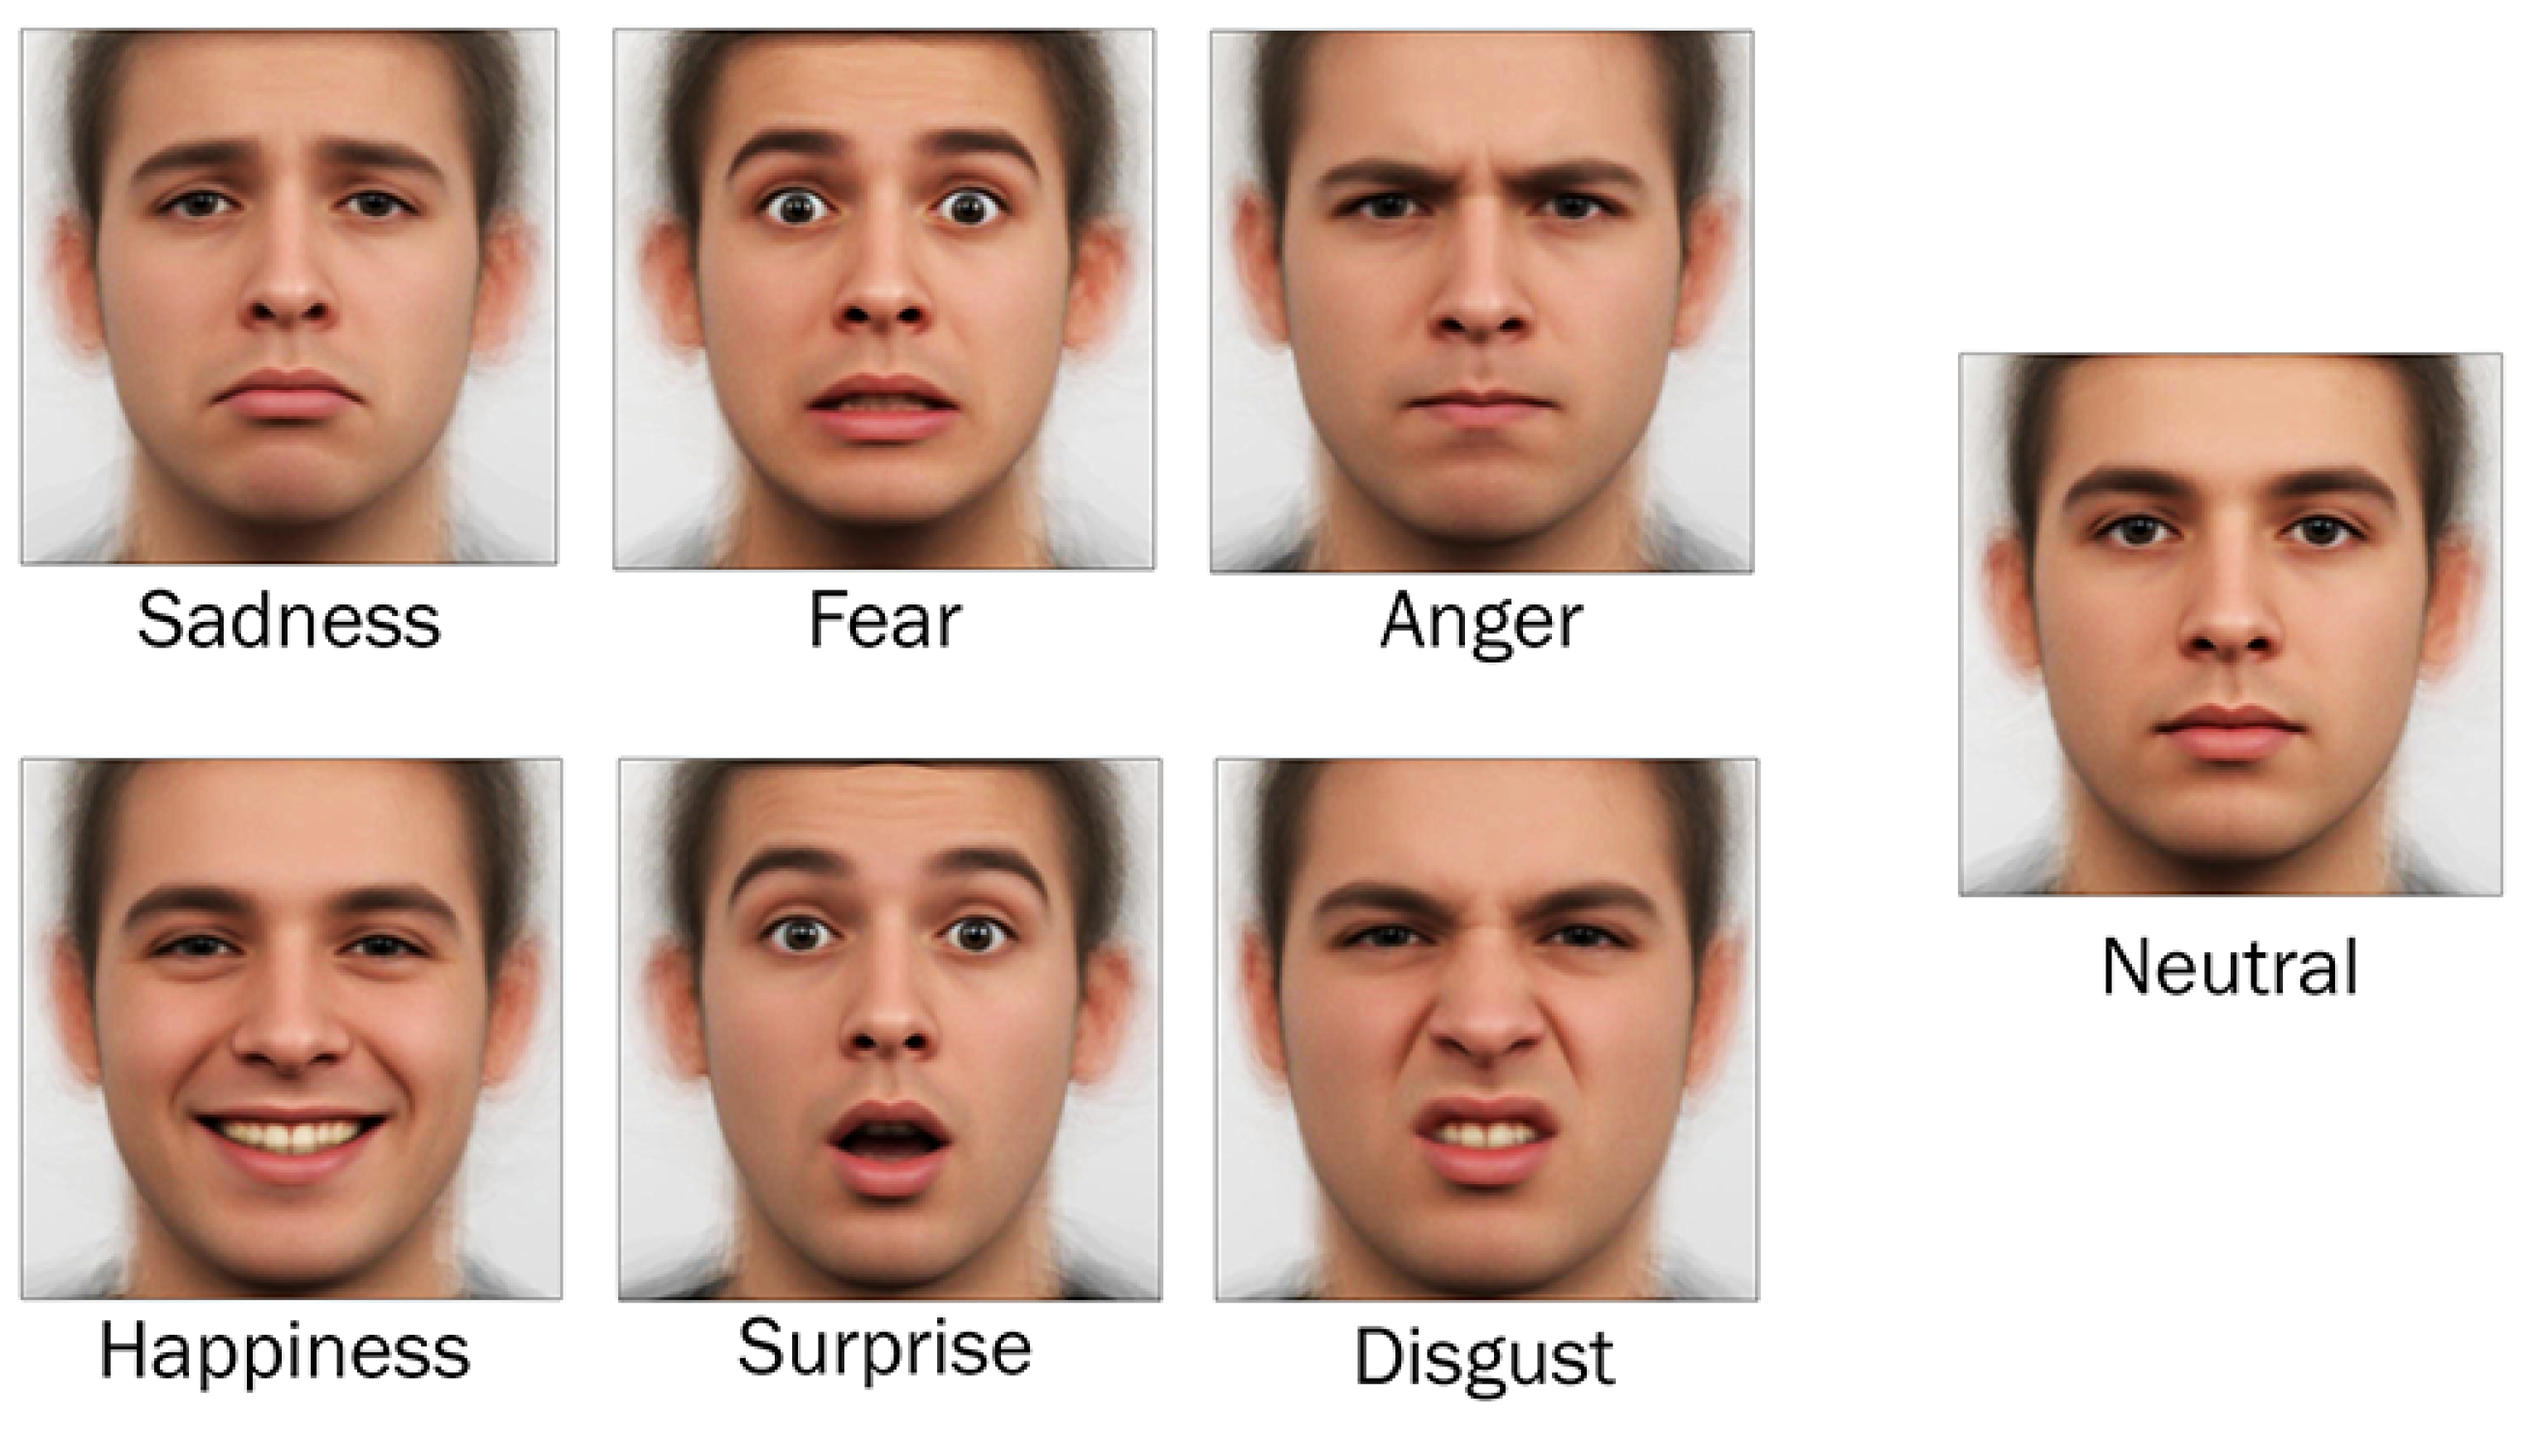

Slide 7
Problem definition
Recognizing facial expressions would help systems to detect if people were happy or sad as a human being can. This will allow softwares and AI systems to provide an even better experience to humans in various applications. From detecting probable suicides and stopping them to playing mood-based music there is a wide variety of applications where emotion detection or mood detection can play a vital role in AI applications.

Slide 8
Objectives
Our main objective is to detect the facial emotion of a person
The system works on CNN (convolutional neural network) for extracting the physiological signals and make a prediction. The results can be drawn out by scanning the person’s image through a camera and then correlate it with a training dataset to predict one’s state of emotions.

Slide 9
Literature review 1
Name - Facial Emotion Detection Using Neural Network
Year - 8-August-2020
Authors - Md. Forhad Ali, Mehenag Khatun, Nakib Aman Turzo
Publisher - Research gate
Description - This paper has been used the Viola-Jones algorithm to detect the eye and lips region from a face and then with the help of the neural network. Also, Machine Learning techniques, Deep Learning models, and Neural Network algorithms are used for emotion recognition. This paper detected emotion from those features from the positioning of the mouth and eyes. This paper will be proposed as an effective way to detect anger, contempt, disgust, fear, happiness, sadness, and surprise

Slide 10
2
Name - Facial emotion recognition using convolutional neural networks (FERC)
Year - 18 February 2020
Authors - Ninad Mehendale
Publisher - SN Applied Sciences
Description - In this paper, they propose a novel technique called facial emotion recognition using convolutional neural networks (FERC). The FERC is based on two-part convolutional neural network (CNN): The first-part removes the background from the picture, and the second part concentrates on the facial feature vector extraction.

Slide 11
3
Name - Facial Emotion Recognition Using Transfer Learning in the Deep CNN
Year - 27 April 2021
Authors - M. A. H. Akhand, Shuvendu Roy, Nazmul Siddique, Md Abdus Samad Kamal, and Tetsuya Shimamura
Publisher – MALI
Description - this study proposes a very Deep CNN (DCNN) modeling through Transfer Learning (TL) technique where a pre-trained DCNN model is adopted by replacing its dense upper layer(s) compatible with FER, and the model is fine-tuned with facial emotion data.

Slide 12
4
Name - Facial Emotion Detection Using Convolutional Neural Networks
Year - 2021
Author - Mohammed Adnan Adil
Publisher - dspace.library
Description - In this paper, a Convolutional Neural Network (CNN) is used to extract features from images to detect emotions. The Python Dlib toolkit is used to identify and extract 64 important landmarks on a face

Slide 13
Hardware Requirements
I3 processor system or higher
4 GB RAM or higher
100 GB ROM or higher
Webcam enabled or an External Camera

Slide 14
Software Requirements
Windows 7 or higher
Python installed on device
Visual studio, jupyter notebook any else

Slide 15
Proposed Methodology
1. Capture Image
2. Image Pre-processing
-RGB to Gray scale conversion
-Scale Normalization
3. Crop Feature Regions
4. Edge Detection
-Prewitt edge detection
5. Facial Emotion Classification

Slide 16
Solutions Proposed
The system detects the faces, and recognizes the emotion on that face.
This can be used in AI technology, to better understand the user.

Slide 17
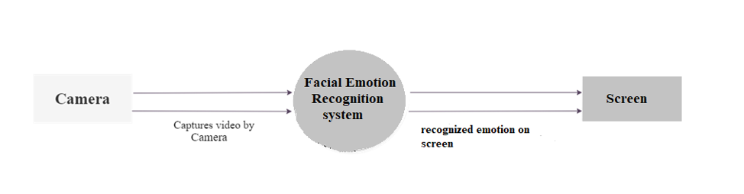
Diagram (0-level DFD)

Slide 18
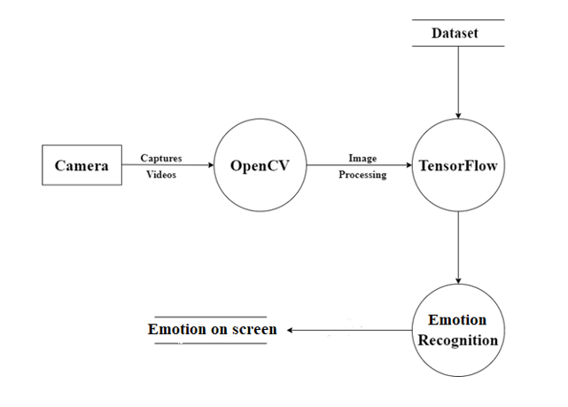
1-level DFD

Slide 19
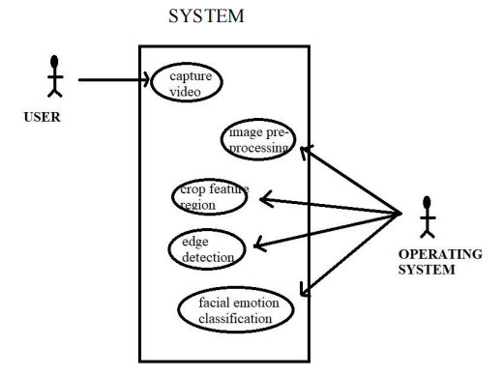
Use Case Diagram

Slide 20
Algorithm
Step 1: Take a still image of a normal expression pic1 (say) of a human face.
Step 2: Converts the color image to grayscale.
Step 3: Crop the five facial image region of interest (ROI) (eyes, eye brows and lip) from the image by defining region.
Step 4: Find edges of all image region.
Step 5: Take a still image of a emotional face (angry or happy) pic2 (say) of same person and repeat step 2, 3 and 4.

Slide 21
Step 6: Comparing the deviation of edges of the specified region of pic1 with pic2 by finding the Euclidian distances of coordinate of each pixel.
Step 7: Put the Euclidian distances in a array k (say).
Step 8: Find the standard deviation (SD) from the elements of array.
Step 9: Comparing the SD with pre-define threshold.
Step 10: get the emotions.

Slide 22
Implementation Some screenshots of our work

Slide 23

Testing
Testing is the process of evaluation of a system to detect differences between given input and expected output and also to assess the feature of the system. Testing assesses the quality of the product. It is a process that is done during the development process.
The texting method used here is Black Box Testing. It is carried out to test functionality of the program. It is also called ‘Behavioral’ testing. The tester in this case, has a set of input values and respective desired results. On providing input, if the output matches with the desired results, the program is tested ‘ok’, and problematic otherwise.

Slide 24
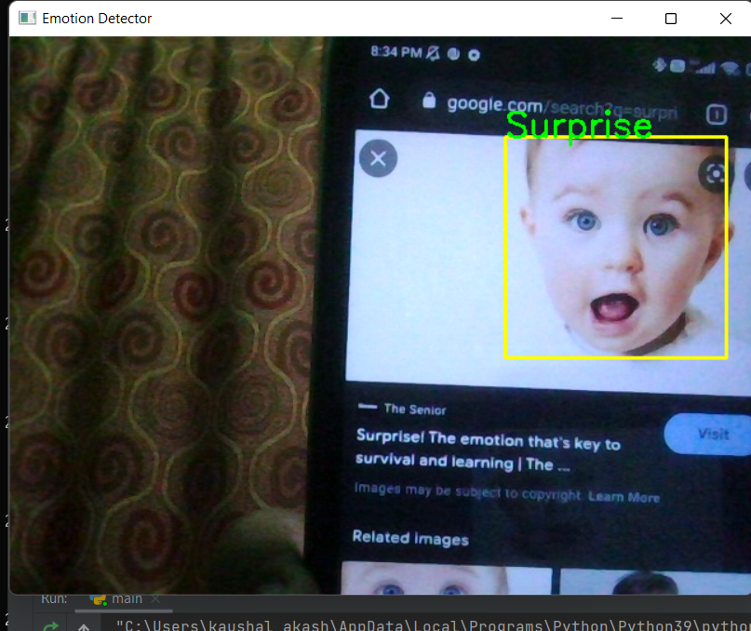
Test cases
Test case Id | TC001
Test case summary | It will check whether the system detects the emotion or not.
Test procedure | Place and start the camera
Expected result | There should be written “Surprise” on bounding box
Exact result | “Surprise” is written on the detected face.
Status | Pass

Slide 25
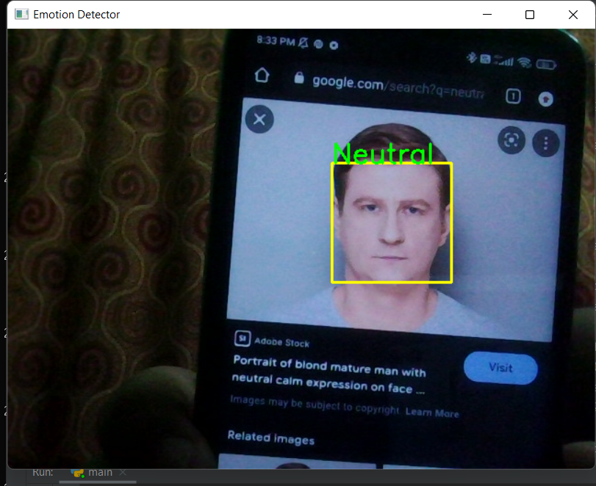
Test case Id | TC002
Test case summary | It will check whether the system detects the emotion or not.
Test procedure | Place and start the camera
Expected result | There should be written “Neutral” on bounding box
Exact result | “Neutral” is written on the detected face.
Status | Pass

Slide 26
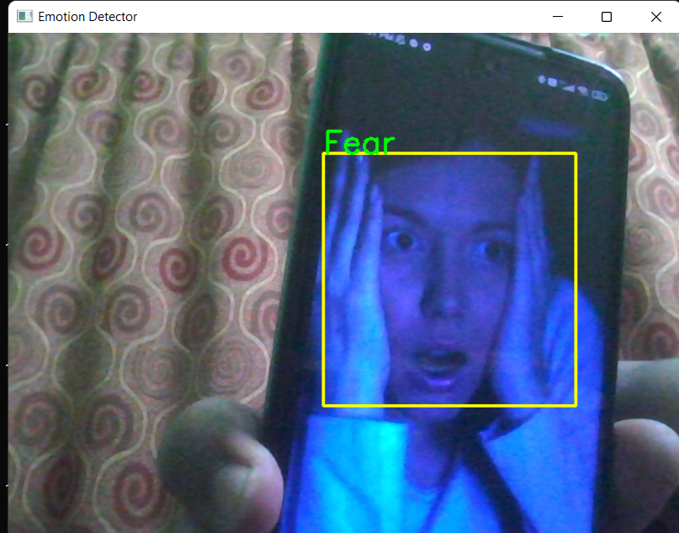
Test case Id | TC003
Test case summary | It will check whether the system detects the emotion or not.
Test procedure | Place and start the camera
Expected result | There should be written “Fear” on bounding box
Exact result | “Fear” is written on the detected face.
Status | Pass

Slide 27
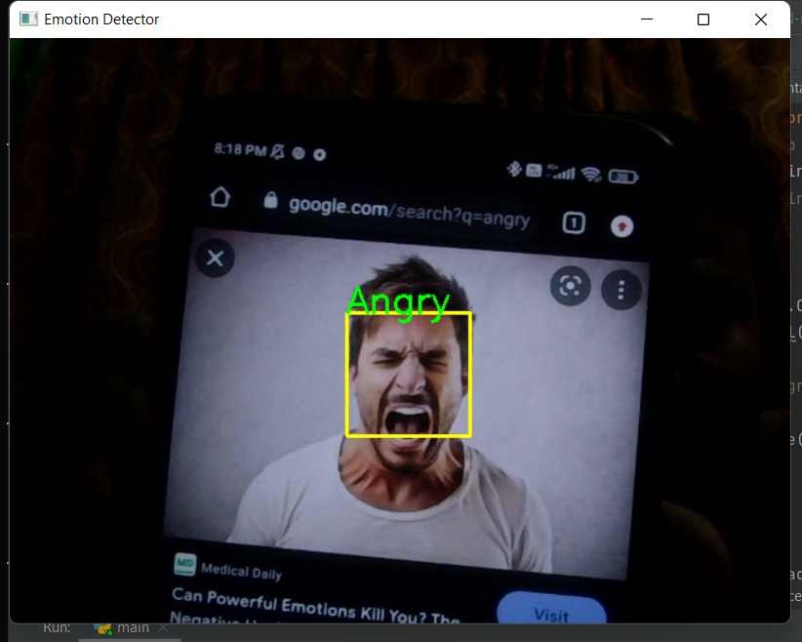
Test case Id | TC004
Test case summary | It will check whether the system detects the emotion or not.
Test procedure | Place and start the camera
Expected result | There should be written “Angry” on bounding box
Exact result | “Angry” is written on the detected face.
Status | Pass

Slide 28
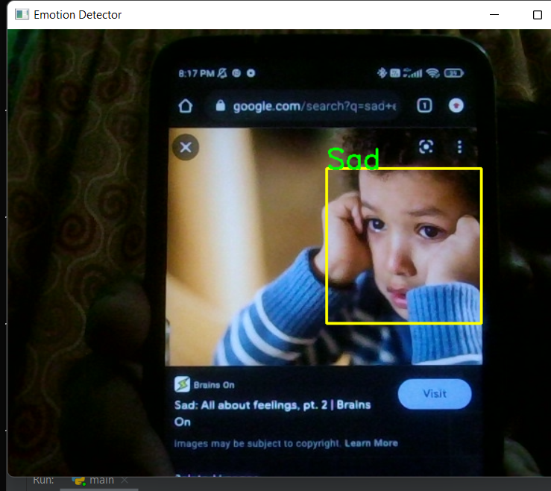
Test case Id | TC005
Test case summary | It will check whether the system detects the emotion or not.
Test procedure | Place and start the camera
Expected result | There should be written “Sad” on bounding box
Exact result | “Sad” is written on the detected face.
Status | Pass

Slide 29
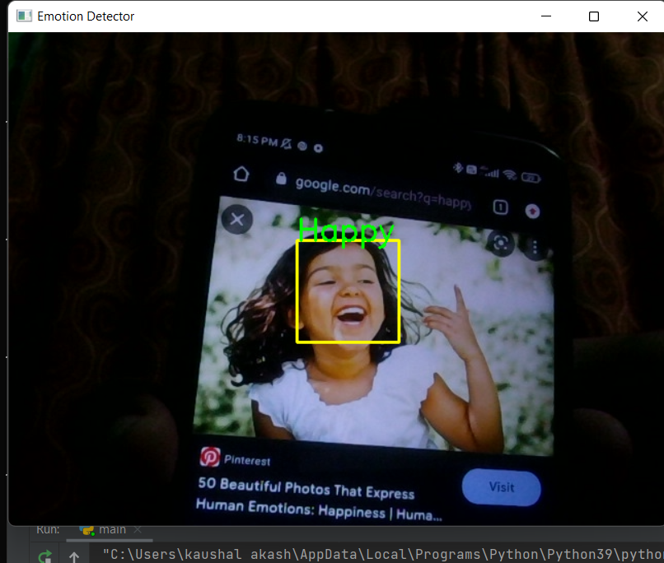
Test case Id | TC006
Test case summary | It will check whether the system detects the emotion or not.
Test procedure | Place and start the camera
Expected result | There should be written “happy” on bounding box
Exact result | “Happy” is written on the detected face.
Status | Pass

Slide 30
Conclusion and Limitations
Conclusion
Emotion recognition project is used to detect face emotions and This will allow software's and AI systems to provide an even better experience to humans in various applications
Limitations
Working will be little slow because frameworks used need high-processing hardware & GPU.
If the face is not clearly visible, then it is difficult to recognize.

Slide 31


